Slide 1
Tools and Technologies in OSSE- Collaboration and Communication tools on GitHub
Dr. Ritu Arora
Associate Professor (Off-Campus)
Department of Computer Science & Information Systems
BITS, Pilani

Slide 2
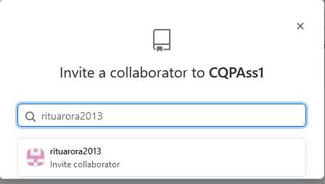
Adding Collaborators to a GitHub repo
Navigate to the repo to which you want to add collaborators.
Click the Setting button - > and then Manage button on left side panel
Invite collaborators using the “Invite” button

Slide 3
Email Notifications
An email notification mechanism is put in place for communication.
The owner of the repo gets a notification through email when a pull request is placed.
This email notification consists of the following:
provides a list and a diff of the files that have been proposed changed in the Pull Request.
it also provides a link to navigate to the Pull Request on GitHub.

Slide 4
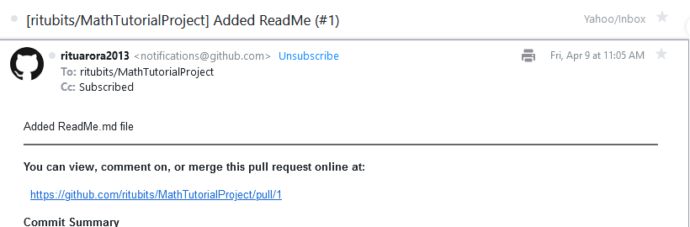
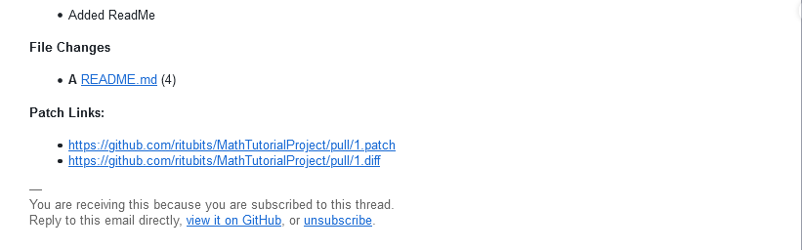
Figure depicting email notification received by the owner/maintainer of the public project repo

Slide 5
Collaborating on Pull request
GitHub provides collaboration mechanism on Pull request through the conversation page or the discussion page, with the contributor who created the pull request.
The project owner can comment on the entire pull request or the entire commit or choose specific lines of code and comment on the same.
Other collaborators / contributors may also provide comments on the Pull Request.
In this case, the owner of the project will continue to get email notifications about the discussion on the Pull request.

Slide 6
Managing Issues
Issues help to keep track of tasks, enhancements, and bugs for a project.
An issue in GitHub consists of the following:
A title and description which helps to describe additional details about an issue.
Color-coded labels help to categorize and filter issues.
A milestone acts like a container for issues. This help in associating issues with specific features or project phases
Issues can also be mapped to assignees - who would then be responsible for working on the issue at any given time.

Slide 7
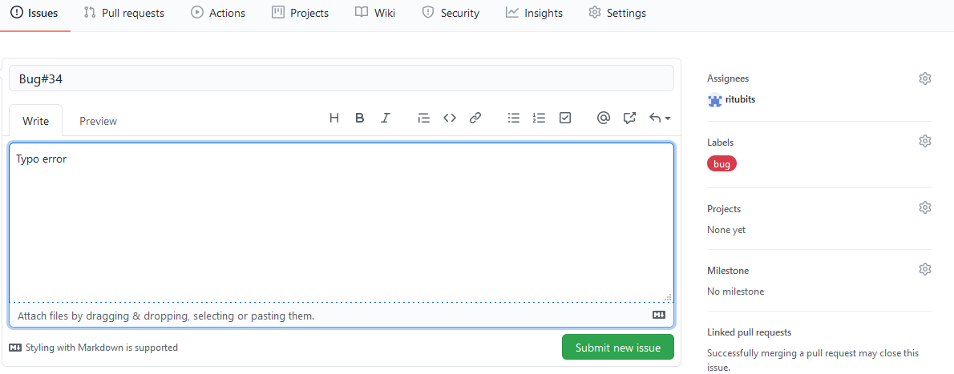
Managing Issues

Slide 8
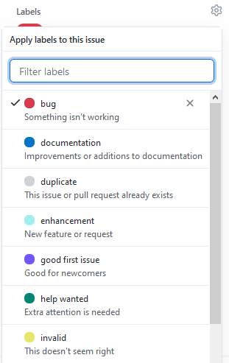
Milestone, Label and Assignees
Milestones, labels, and assignees help in filtering and categorizing issues.
Use the ‘gears’ button on the sidebar on the right in order to add or change labels, assignees and milestones.

Slide 9
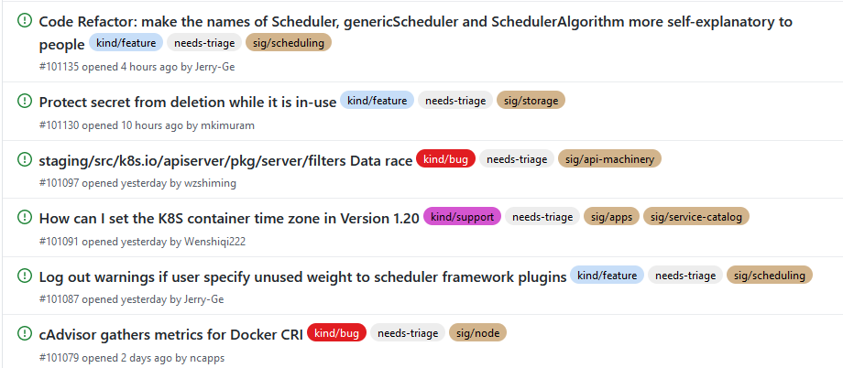
Labels
Labels help to categorize issues into different categories
An issue can have multiple labels; can filter issues on these labels - one by one or many labels at a time

Slide 10
Mentions and Notifications
GitHub also provides another notifications system called mentions – this can be used when you would want to pull in people into discussions and need feedback from them
For this, in a comment, you need to start typing with the ‘@’ character and it will begin to autocomplete with the names and usernames of people who are collaborators or contributors in that project – this is called mentions.
On posting a comment with a user mention, that user will be notified.
This notification mechanism proves to be an effective way of involving people into discussion.

Slide 11
Mentions and Notifications
Whenever a user gets mentioned on a issue or pull request, he/she gets be “subscribed” to it and will start to get all related notifications.
Moreover, by default, a contributor is be subscribed to something that he/she opened, or is watching a repository or comments on something.
In order to stop receiving notifications, use the “Unsubscribe” button– as shown in figure here:

Slide 12
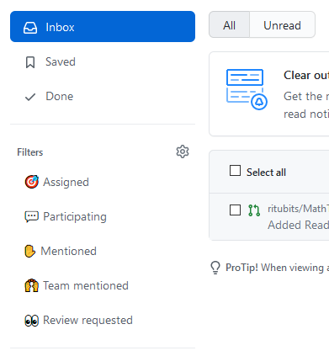
More on Notifications
You can also click on the “bell” icon placed on extreme right corner in your GitHub page.
It shows an inbox containing all the notifications sent to you.
You can organize these notification in “saved” and “done” folders.
You can assign more filters to these messages – using the left panel options.
Use the “Manage Notifications” option to access notification settings page.

Slide 13
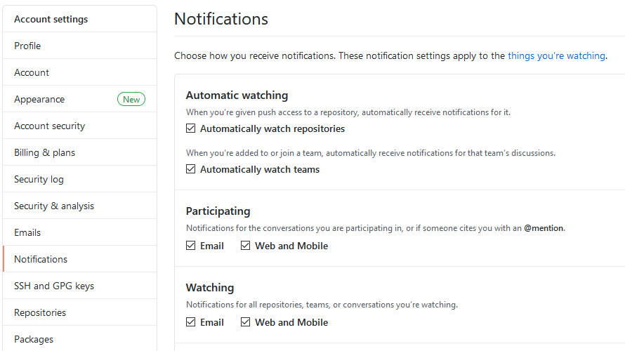
Notification Settings

Slide 14
Watching a repo
You can start watching a repo by simply navigating to that repo from your login and click on the Watch icon on the extreme right corner, close to fork button.
If you are watching a repository, you will receive notifications for all conversations — project issues, pull requests, comments on commits and any other comments.
In case you have push access to a repository- GitHub automatically adds it to your watch list – this is an auto-watch feature.
To unwatch a repo, navigate to notification settings -> list of all watch repo and selectively unwatch them.

Slide 15
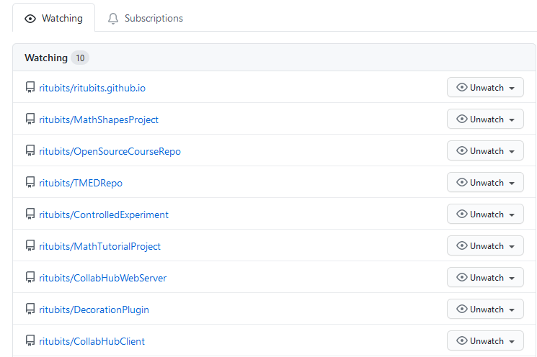
Un-Watching a repo

Slide 16
Star a repo
You can star a repo by simply navigating to that repo from your login and click on the Star icon on the extreme right corner, next to fork button.
When you star a project you can keep track of it, but you won't be notified of every change.
In order to star a repo, use the star button next to the watch button on the home page of every repository.

Slide 17
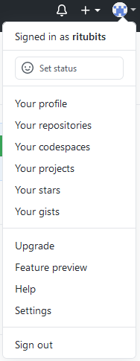
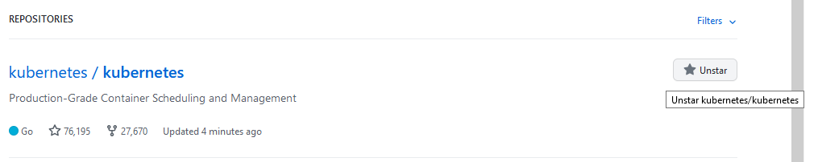
Unstar a repo
Step1:
Step 2:

Slide 18
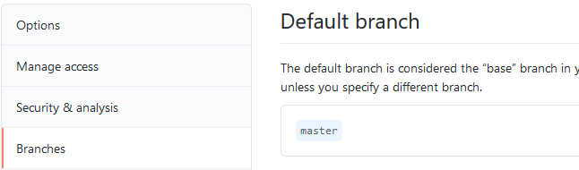
Project Administration: Changing the default branch
If you are willing to use a branch other than the “master” as your default branch,
and want that people should open Pull Requests on it or see it as default,
then, navigate to the repository’s settings page under the “Branches” tab and change the branch:

Slide 19
Change visibility of a repo
Navigate to “Settings”- > Option -> Danger Zone -> Change visibility
Making a repo private:
GitHub will detach public forks of the public repository
Changing a repository's visibility from internal to private will remove forks that belong to any user without access to the newly private repository.
Any published GitHub Pages site will be automatically unpublished.
Making a repo public
GitHub will detach all private forks and turn them into a standalone private repository.

Slide 20
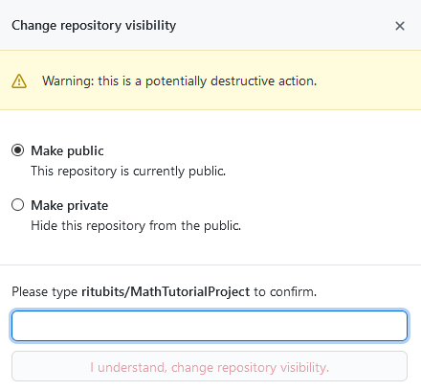
Change visibility of a repo

Slide 21
Transfer a project
In order to transfer a project to another user or an organization in GitHub, use the “Transfer ownership” option at the bottom of the “Options” tab of your repository settings.
This is helpful in case a project is to be abandoned and someone else wants to take it over,
or if the project is getting bigger and you want to move it into an organization.
This will move the repository along with all its watchers and stars to another place.
It will also sets up a redirect from your URL to the new place.

Slide 22
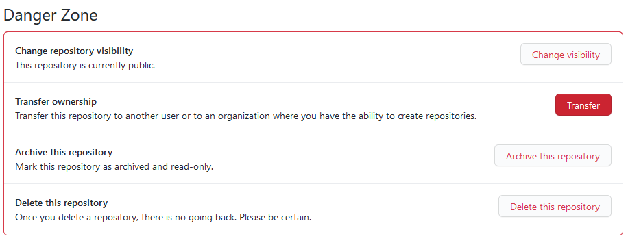
Transfer a project

Slide 23
Archive a repo
You can archive a repository to make it read-only for all users and indicate that it's no longer actively maintained.
You can also unarchive repositories that have been archived.
It is recommend that you close all issues and pull requests, as well as update the README file and description, before you archive a repository.
Navigate to “Settings”- > Option -> Danger Zone -> Archive this repo

Slide 24
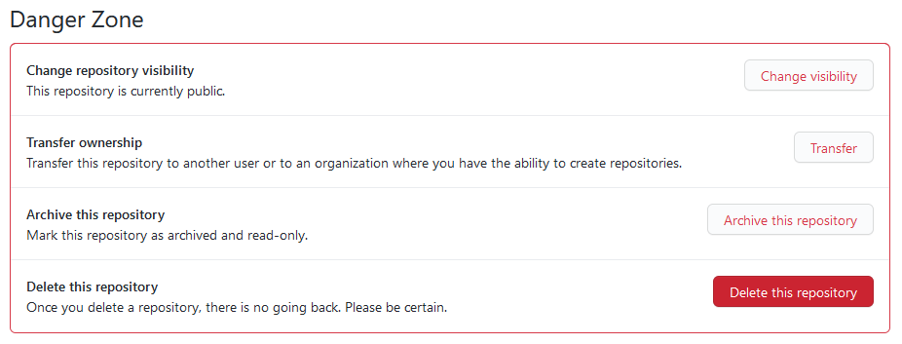
Delete a repo
Only members with owner privileges for an organization or admin privileges for a repository can delete an organization repository.
Deleting a public repository will not delete any forks of the repository.
Navigate to “Settings”- > Option -> Danger Zone:

Slide 25
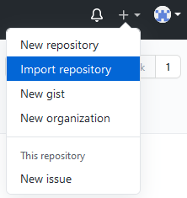
Import a repo in GitHub
If you have a public project hosted on another version control system, you can automatically import it to GitHub using the GitHub Importer tool.
You will be prompted to enter the URL of the old repo
This is followed by the steps which are same when you create a new repo in GitHub.

Slide 26
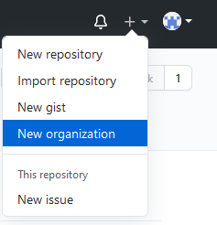
Managing an Organization
GitHub also provides the option to create organizations, with shared ownership of project repositories.
For creating a new organization, click on the “+” icon on the top right corner of your GitHub page and select “New organization”
Give an appropriate name to your organization and an email id.
Now invite co-owners to the account.

Slide 27
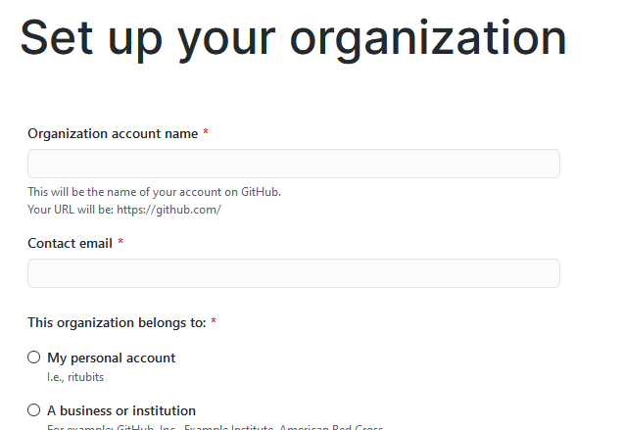
Managing an Organization

Slide 28
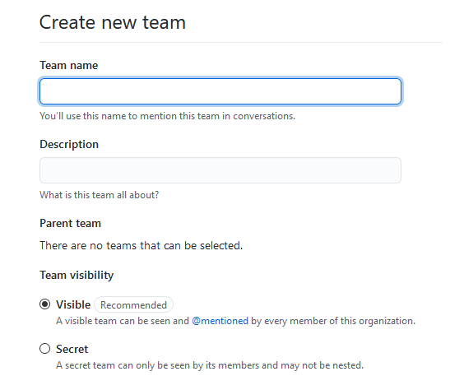
Creating Teams
You may also divide people belonging to your organization into teams.
For e.g. – You may have teams like – front end developers team, back-end team etc.
Create repositories with in a team and assign members to it.

Slide 29
Thank You!
In our next session:
Tools and Technologies in OSSE–
Understanding Markdown

